Slide 1
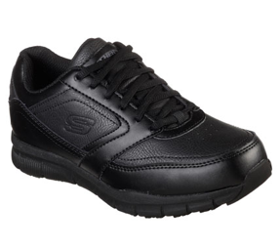
Product Data Sheet​
​
Product Code: 77235EC BLK
​Product Name: NAMPA - WYOLA
Size Range: 3-8
Standard: EN ISO 20347:2012
Category: OB FO SRC
Construction/Features and Benefits​
Lace up sporty casual comfort slip resistant work sneaker design
Synthetic overlays at toe, sides and heel for added durability
Side S logo
Padded collar and tongue
Soft fabric shoe lining
Relaxed Fit® design for a roomier comfortable fit
Memory Foam full length cushioned removable comfort insole
Smooth synthetic upper
Slip Resistant flexible rubber traction outsole
Weight is 255g in a Women's Size 6

