Slide 1
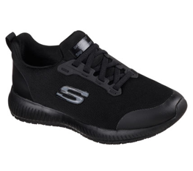
Product Data Sheet
Product Code: 77222EC
Colors: BLK / WHT / NVY / BKRG
Product Name: SQUAD SR
Size Range: 3-8
Standard: EN ISO 20347:2012
Category: OB E FO SRC
Construction/Features and Benefits
Occupational Footwear
Memory Foam topped cushioned full length comfort insole.
Soft smooth knit mesh fabric upper with Scotchgard® liquid and stain protection.
Slip Resistant rubber traction outsole
Energy absorption around heel
Smooth synthetic overlays at toe, heel and laces for added durability
Slip on stretch laced sporty casual work slip resistant comfort sneaker
Smooth 3D printed synthetic toe and heel protective overlays
Stretch laced front panel for easy slip-on fit
Heel panel fabric overlay with pull on top tab
High apex design front panel for added comfort
Lightweight flexible shock absorbing midsole
1 1/4 inch heel height
Weight is 215g in a women’s Size 6

