Slide 1
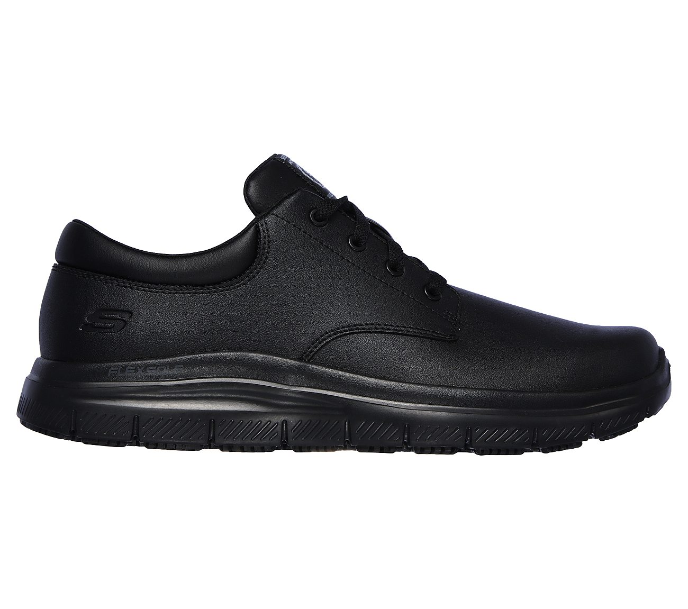
Product Data Sheet
Product Code: 77513EC BLK
Product Name: FLEX ADVANTAGE - FOURCHE SR
Size Range: 6-13
Standard: EN ISO 20347:2012
Category: OB FO SRC
Construction/Features and Benefits
Occupational Footwear
Resistant to oil and petrol
Slip resistance on ceramic tile floors with sodium lauryl sulfate
Slip resistance on steel floors with glycerol
Lace up dress casual comfort slip resistant work oxford
Reinforced stitched seams
Synthetic heel and collar overlays
Rounded plain toe front
Lace up front with metal eyelets
Padded collar and tongue
Relaxed Fit® design for a roomy comfortable fit
Memory Foam full length cushioned comfort insole
Smooth leather and synthetic upper
FlexSole lightweight shock absorbing midsole
1 1/4 inch built in heel
Slip Resistant rubber traction outsole
Weight is 297g in a Men's Size 9

