Slide 1
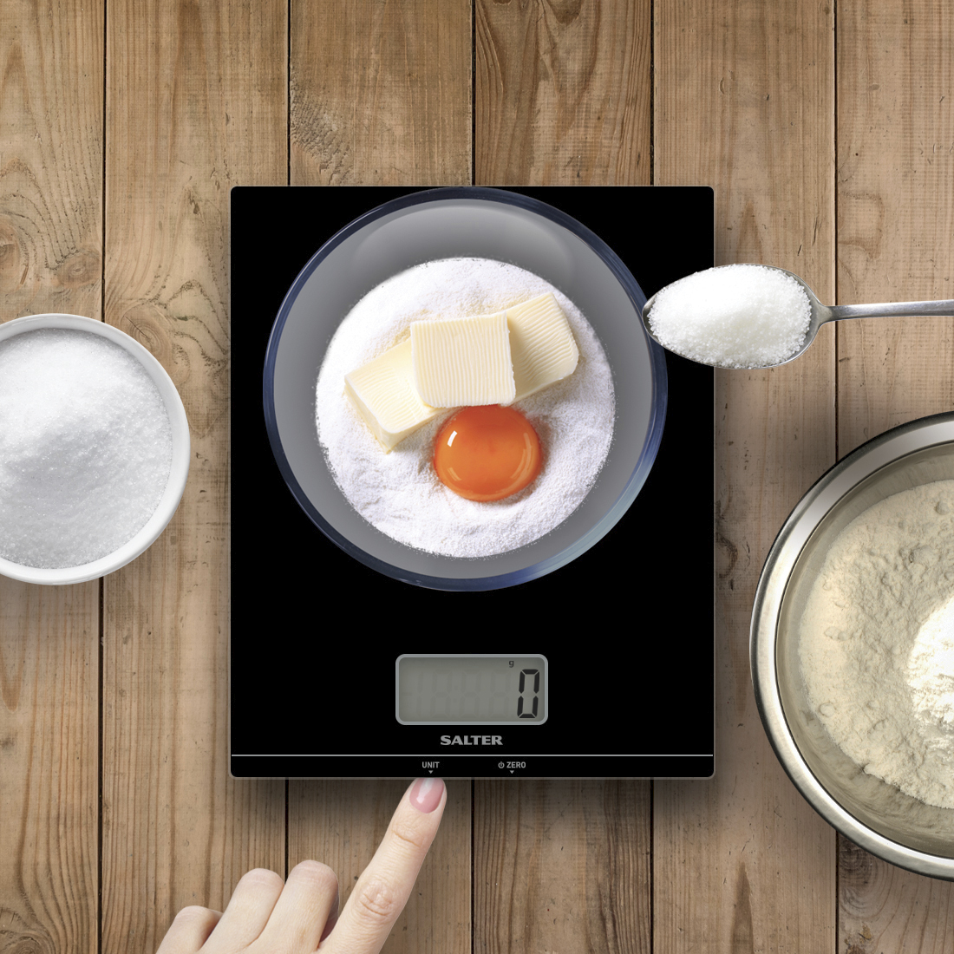
GLASS ELECTRONIC SCALE
Ultra slim glass platform - hygienic and easy to clean
Easy to read large digit display – size 5.5 x 2.5cm
Aquatronic function - for measuring liquids in ml or fl.oz
Add & Weigh ‘zero’ function – allows for measurement of multiple ingredients in the same bowl
Weigh directly on the platform or weigh with own mixing bowl – suitable for use with most bowls or containers
Slim design for neat storage
Product size 18.4 x 22.4 x 1.6 cm
5000g | 11lb | 5000ml | 176 fl.oz
1g | 0.1oz | 1ml | 0.1fl.oz

